Slide 1


INF 164
PRACTICAL 5
2021

Slide 2
Important concepts to be covered in this practical session…
  DataGridViews and Collection of Objects (Arrays & Lists)
  Classes and Objects
  Passing data between forms

Slide 3

What are we going to do?
  In this practical session, you are going to create a program that
  Part 1: Inventory management application
  Part 2: Self-study (Recap on today's practical)

Slide 4
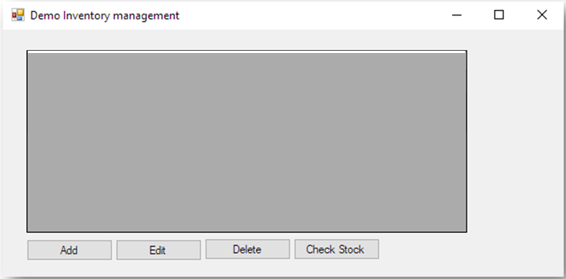
Practical 5 Part 1: DataGridView Screen Design
  The following program is a demo inventory windows form application. This application should allow its user to add, edit and delete a product item. The application should also provide an option to check if a product item is low on stock to prevent stock outage.
Start by creating a new windows form screen design as follows. (frmMain)

Slide 5
Practical 5 Part 1: Screen Design
  The following controls will be responsible for ;
    ADD button
    – adding a new product item on the dgv with the use of an additional form (frmAddProduct).
    EDIT button
    – for editing a selected product on the dgv with the use of an additional form (frmEditProduct).
    DELETE button
    – for deleting a selected product on the dgv.
    CHECK STOCK button
    – for checking if the selected product on the dgv has more or less than 20 units in stock.

Slide 6
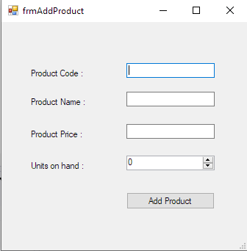
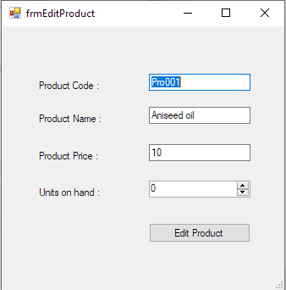
Practical 5 Part 1: ADD & EDIT forms Screens
The additional screens (frmAddProduct and frmEditProduct) are as follows;
When the add product button is pressed, the dgv will be updated with a new product item.
When the edit product button is pressed, the dgv product item will be updated.

Slide 7
Practical 5 Part 1: Product Class (Lecture 4)
  For the application to create product objects / items, a Product Class should be created, with the following data members:
  mProductCode of type string.
  mProductName of type string.
  mUnitPrice of type double.
  mUnitsinStock of type int.
The class should also have a Boolean method to check for stock levels less than or more than 20 units. The Boolean result will be used to display the appropriate MessageBox() message to the user.
Also create appropriate constructor methods for the class.
Make sure the class's access modifier is public: public class Products.

Slide 8

Practical 5 Part 1: Collection of Objects
  On the Form Load Event handler, we are going to populate the DataGridView with a list of objects as shown in the image below.
  In order to archive this, you will need a list of objects / items e.g. (an array or list or binding list)

Slide 9
Practical 5 Part 1: ADD, EDIT & DELETE Code
The code to the application will be presented in the practical session and later uploaded under the practical solutions for prac 5.

Slide 10
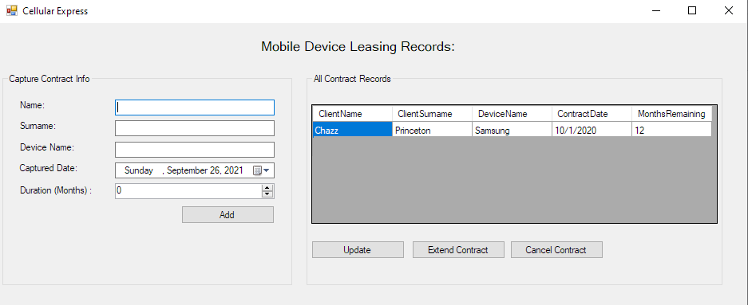
Practical 5: Part 2 Self Study Question
The objective for this self-study question is to design a windows form project which will manage the contracts of leasing cellular devices to various clients. The lease record management application should allow the currently logged in user
To view all the contract records of leased devices when the below form loads
frmCellurExpress Design

Slide 11
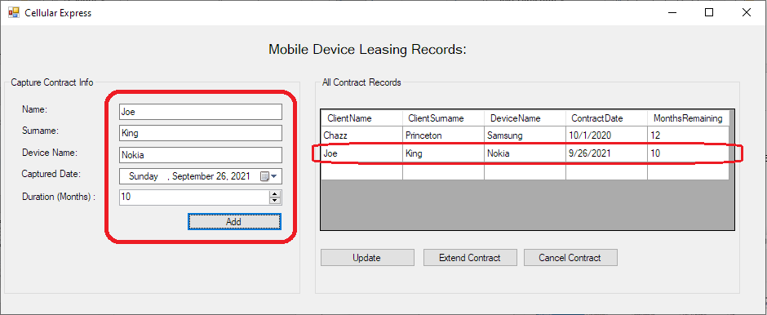
Practical 5: Part 2 Self Study Question
To add a new contract record of a leased device with the client details.
frmCellurExpress Design

Slide 12
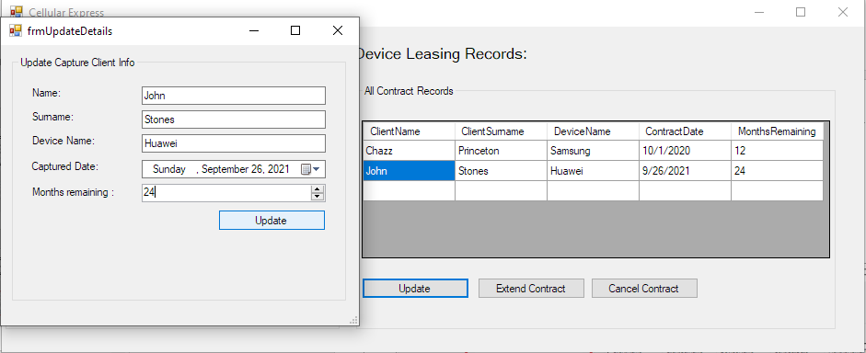
Practical 5: Part 2 Self Study Question
To update a selected contract on the dgv with the use of an additional form (frmUpdateDetails)
frmCellurExpress Design

Slide 13
Practical 5: Part 2 Self Study Question
To delete a selected contract on the dgv when the “Cancel Contract” button is pressed.
To extend the contract duration of an existing contract record by 3 months on the dgv when the “Extend Contract” button is pressed.
HINTS
  Create a class called Contracts with the following;
    mClientName of type string.
    mClientSurname of type string.
    mDeviceName of type string.
    mContractDate of type datetime.
    mMonth of type int.
    appropriate constructor methods
    ExtendContract void method
  Ensure that the access modifier of the class is public: public class Contracts
  Remember to use a binding list

Slide 14
Questions ?

